Slide 1


22CAC09
FULL STACK DEVELOPMENT
UNIT – II
JavaScript (JS)

Slide 2
JavaScript
JavaScript
(often shortened to JS)
lightweight,
interpreted,
object-oriented language.

Slide 3
JavaScript
JavaScript, which was originally developed at Netscape by Brendan Eich, was initially named Mocha but soon after was renamed LiveScript.
In late 1995 LiveScript became a joint venture of Netscape and Sun Microsystems, and its name again was changed, this time to JavaScript.
A language standard for JavaScript was developed in the late 1990s by the European Computer Manufacturers Association (ECMA) as ECMA-262.
The ECMA-262 standard is now in version 12.

Slide 4
JavaScript Vs. JScript
JavaScript: It is a scripting language whose trademark is Oracle Corporation.
JScript: It is also a scripting language but owned by Microsoft.
JavaScript: One need to handle multiple browser compatibility by writing code
JScript: It’s only support Microsoft Internet Explorer.

Slide 5
JavaScript Comments
Single-line Comment
<script>
// It is single line comment
document.write("Hello Javascript");
</script>
Multi-line Comment
<script>
/* It is multi line comment. It will not be displayed */
document.write("Javascript multiline comment");
</script>

Slide 6
Why JavaScript?
JavaScript is one of the 3 languages all web developers must learn:
1. HTML to define the content of web pages.
2. CSS to specify the layout of web pages.
3. JavaScript to program the behavior of web pages.

Slide 7
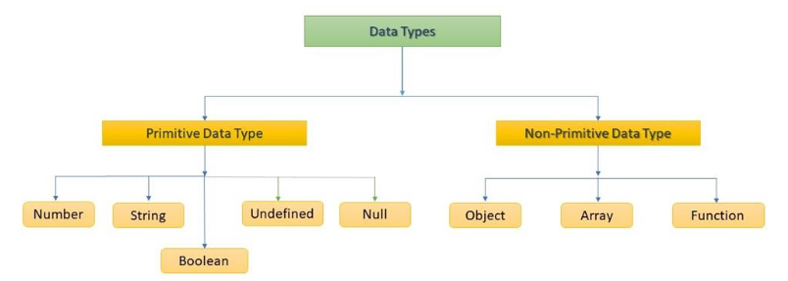
JavaScript Data Types
The data type is a basic type of data that can be used in a program.
In JavaScript, there is no need to specify the type of variable because it is dynamically used by JavaScript Engine.

Slide 8
JavaScript Data Types
Data Types | Description | Example
String | Represents Textual Data | 'hello', "hello world!" etc
Number | An Integer or a Floating-Point Number | 3, 3.234, 3e-2 etc.
Boolean | True or False | true and false
undefined | A Data type whose variable is not initialized | let a;
null | Denotes a Null Value | let a = null;
Object | Key-Value Pairs of Data | let student = { };

Slide 9
JavaScript Data Types
let length = 16; // Number
let lastName = "Johnson"; // String
let x = {firstName:"John", lastName:"Doe"}; // Object
const dataChecked = true; //Boolean
let name; //undefined
const number = null; //null
let person = { firstName: 'John', lastName: 'Doe' }; // Object

Slide 10
JavaScript Data Types
JavaScript evaluates expressions from left to right.
Different sequences can produce different results.
let x = 16 + "Volvo"; 16Volvo
let x = 16 + 4 + "Volvo"; 20Volvo
let x = "Volvo" + 16 + 4; Volvo164
const number1 = 3/0; +Infinity
const number2 = -3/0; -Infinity

Slide 11
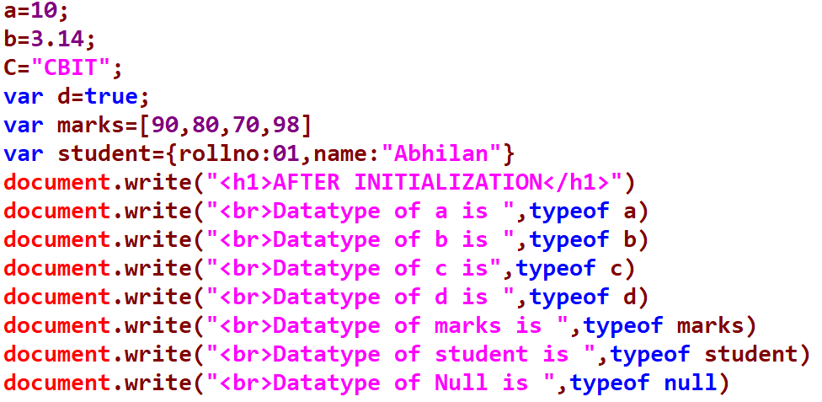
JavaScript Data Types
To find the type of a variable, you can use the typeof operator.

Slide 12
JavaScript Type Conversion
In programming, type conversion is the process of converting data of one type to another. For example: converting String data to Number.
There are two types of type conversion in JavaScript.
Implicit Conversion - automatic type conversion.
Explicit Conversion - manual type conversion.

Slide 13
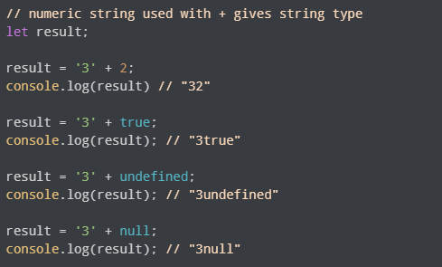
JavaScript Type Conversion
JavaScript automatically converts one data type to another (to the right type). This is known as implicit conversion.
Implicit Conversion to String

Slide 14
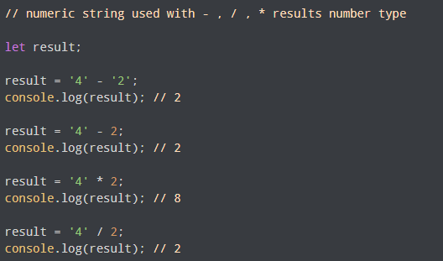
Implicit Conversion to Number

Slide 15
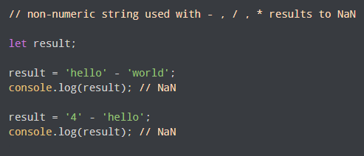
Non-numeric String Results to NaN

Slide 16
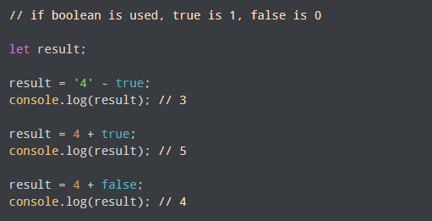
Implicit Boolean Conversion to Number

Slide 17
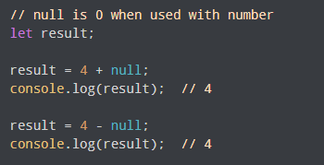
Null Conversion to Number

Slide 18
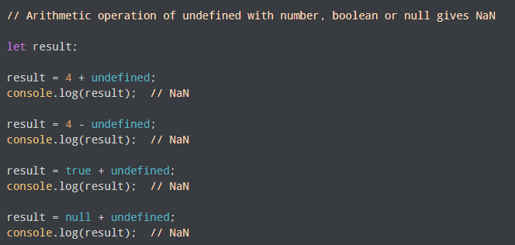
Undefined used with Number, Boolean or Null

Slide 19
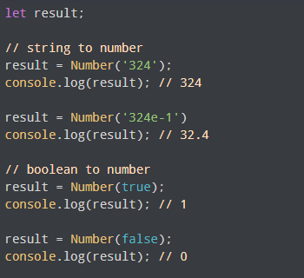
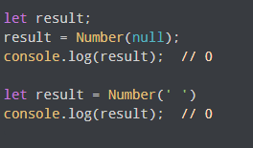
JavaScript Explicit Conversion

Slide 20
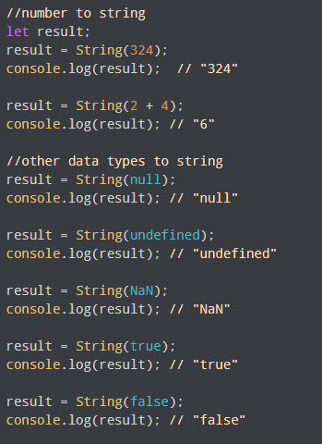
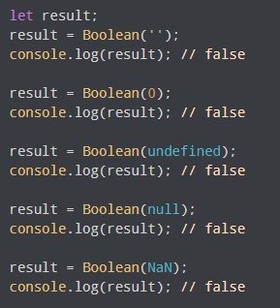
Convert to String/Boolean Explicitly

Slide 21
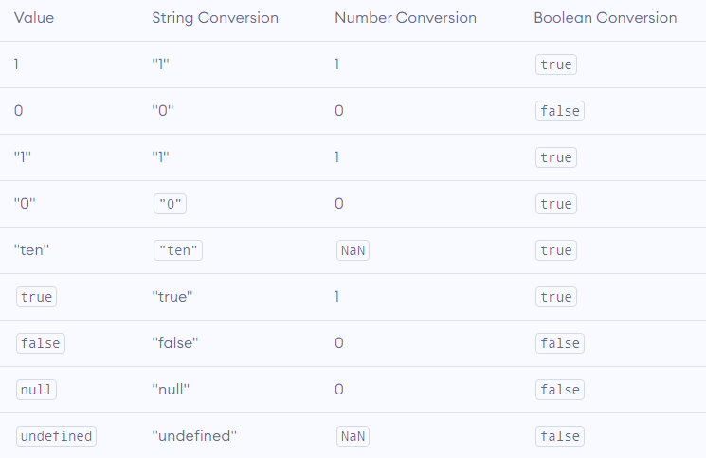
JavaScript Type Conversion Table

Slide 22
JavaScript Display Possibilities
Writing into an HTML element, using innerHTML.
Writing into the HTML output using document.write().
Writing into an alert box, using window.alert().
Writing into the browser console, using console.log().

Slide 23
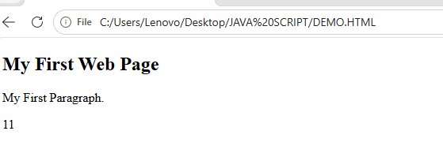
JavaScript Display Possibilities
<!DOCTYPE html>
<html>
<body>
<h2>My First Web Page</h2>
<p>My First Paragraph.</p>
<p id="demo"></p>
<script>
document.getElementById("demo").innerHTML = 5 + 6;
</script>
</body>
</html>

Slide 24
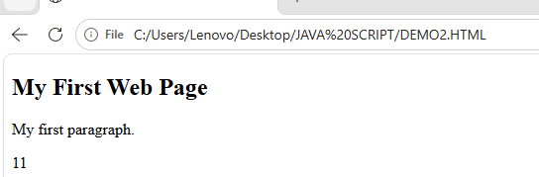
JavaScript Display Possibilities
<!DOCTYPE html>
<html>
<body>
<h2>My First Web Page</h2>
<p>My first paragraph.</p>
<script>
document.write(5 + 6);
</script>
</body>
</html>

Slide 25
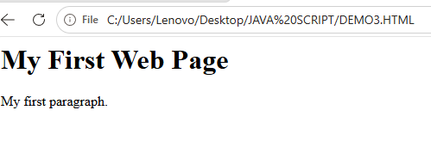
JavaScript Display Possibilities
<!DOCTYPE html>
<html>
<body>
<h1>My First Web Page</h1>
<p>My first paragraph.</p>
<script> window.alert(5 + 6);
</script>
</body>
</html>

Slide 26

JavaScript Display Possibilities
<!DOCTYPE html>
<html>
<body>
<script> console.log(5 + 6);
</script>
</body>
</html>

Slide 27
Methods of window object
Method | Description
alert() | Displays the alert box containing message with ok button.
confirm() | Displays the confirm dialog box containing message with ok and cancel button.
prompt() | Displays a dialog box to get input from the user.
open() | Opens the new window.
close() | Closes the current window.
setTimeout() | Performs action after specified time like calling function, evaluating expressions etc.

Slide 28
JavaScript Object
This code assigns a simple value to a variable named car:
var car = "Fiat";
Objects are variables too. But objects can contain many values.
JavaScript objects are containers for named values called properties or methods.
var car = {type:"Fiat", model:"500", color:"white"};
var person = {firstName:"John", lastName:"Doe", age:50}

Slide 29
JavaScript Arrays
An array is a special variable, which can hold more than one value at a time.
JavaScript arrays are used to store multiple values in a single variable.
Creating an Array
var array_name = [item1, item2, ...];
var array_name = new Array(“item1”, ”item2”, ”item3");
var cars = ["Saab", "Volvo", "BMW"];
var cars = new Array("Saab", "Volvo", "BMW");
Array indexes start with 0.
[0] is the first element. [1] is the second element.

Slide 30
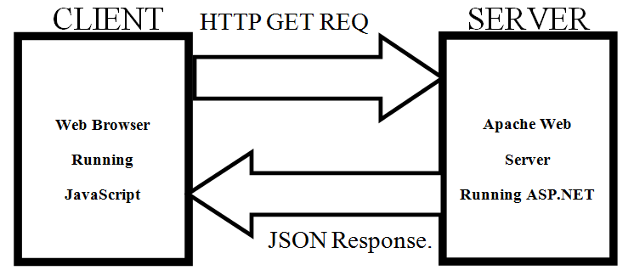
JSON
JSON is a format for storing and transporting data.
JSON is often used when data is sent from a server to a web page.
JSON stands for JavaScript Object Notation.
JSON is lightweight data interchange format.
JSON is language independent.
JSON is "self-describing" and easy to understand.

Slide 31
JSON
It is a textual way to represent objects by using two structures:
Collections of name-value pairs
Arrays of values.
The primary reason to use JSON instead of XML is to eliminate the complexity of parsing.
JSON is easy for people to read and write, and it is easy for machines to parse and generate.
JSON is a way to represent JavaScript objects as strings.

Slide 32
JavaScript Functions and Events
A JavaScript function is a block of JavaScript code, that can be executed when "called" for.
For example, a function can be called when an event occurs, like when the user clicks a button.
Developers can use these events to execute JavaScript coded responses, which cause buttons to close windows, messages to be displayed to users, data to be validated, and virtually any other type of response imaginable.

Slide 33
JSON SYNTAX RULES
Data is in name/value pairs
Data is separated by commas
Curly braces hold objects
Square brackets hold arrays
{ "employees":
[ {"firstName":"John", "lastName":"Doe"}, {"firstName":"Anna", "lastName":"Smith"}, {"firstName":"Peter", "lastName":"Jones"} ] }

Slide 34
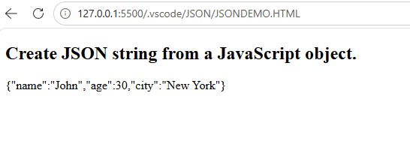
JSON.stringify()
<!DOCTYPE html>
<html>
<body>
<h2>Create JSON string from a JavaScript object.</h2>
<p id="demo"></p>
<script>
var obj = { name: "John", age: 30, city: "New York" };
var myJSON = JSON.stringify(obj);
document.getElementById("demo").innerHTML = myJSON;
</script>
</body>
</html>

Slide 35
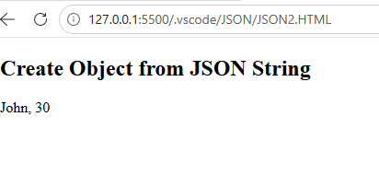
Parse the data From SERVER
<!DOCTYPE html>
<html>
<body>
<h2>Create Object from JSON String</h2>
<p id="demo"></p>
<script>
var txt = '{"name":"John", "age":30, "city":"New York"}'
var obj = JSON.parse(txt);
document.getElementById("demo").innerHTML = obj.name + ", " + obj.age;
</script>
</body>
</html>

Slide 36
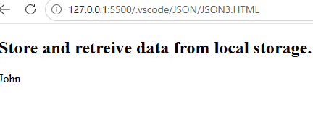
Storing Data
<!DOCTYPE html>
<html>
<body>
<h2>Store and retreive data from local storage.</h2>
<p id="demo"></p>
<script>
var myObj, myJSON, text, obj;
//Storing data:
myObj = { "name":"John", "age":31, "city":"New York" };
myJSON = JSON.stringify(myObj);
localStorage.setItem("testJSON", myJSON);
//Retrieving data:
text = localStorage.getItem("testJSON");
obj = JSON.parse(text);
document.getElementById("demo").innerHTML = obj.name;
</script>
</body>
</html>

Slide 37
Differences between JSON and XML
JSON | XML
JSON stands for JavaScript Object Notation. | XML stands for eXtensible Markup Language.
It is data-oriented. | XML is document-oriented.
JSON doesn't use end tag | XML have end tag.
JSON is shorter | XML is larger than JSON.
JSON is quicker to read and write | XML is not.
JSON can use arrays | XML do not have an array.

Slide 38
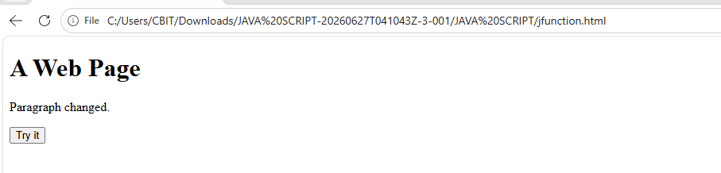
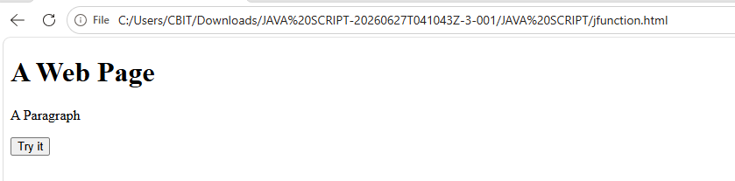
JavaScript Functions and Events
<!DOCTYPE html>
<html>
<head>
<script> function myFunction()
{ document.getElementById("demo").innerHTML = "Paragraph changed."; } </script>
</head>
<body>
<h1>A Web Page</h1>
<p id="demo">A Paragraph</p>
<button type="button" onclick="myFunction()">Try it</button>
</body>
</html>

Slide 39
JavaScript Functions and Events
The change in the state of an object is known as an Event.
Mouse events
Keyboard events
Form events
Window/Document events

Slide 40
JS Mouse events
Event Performed | Event Handler | Description
click | onclick | When mouse click on an element
mouseover | onmouseover | When the cursor of the mouse comes over the element
mouseout | onmouseout | When the cursor of the mouse leaves an element
mousedown | onmousedown | When the mouse button is pressed over the element
mouseup | onmouseup | When the mouse button is released over the element
mousemove | onmousemove | When the mouse movement takes place.

Slide 41
JS Keyboard/Form events
Event Performed | Event Handler | Description
Keydown & Keyup | onkeydown & onkeyup | When the user press and then release the key
Event Performed | Event Handler | Description
focus | onfocus | When the user focuses on an element
submit | onsubmit | When the user submits the form
blur | onblur | When the focus is away from a form element
change | onchange | When the user modifies or changes the value of a form element

Slide 42
JS Window/Document Events
Event Performed | Event Handler | Description
load | onload | When the browser finishes the loading of the page
unload | onunload | When the visitor leaves the current webpage, the browser unloads it
resize | onresize | When the visitor resizes the window of the browser
load | onload | When the browser finishes the loading of the page

Slide 43
JavaScript Events and Objects
Event | Object
onLoad | Body
onUnload | Body
onMouseOver | Link, Button
onMouseOut | Link, Button
onSubmit | Form
onClick | Button, Checkbox, Submit, Reset, Link

Slide 44
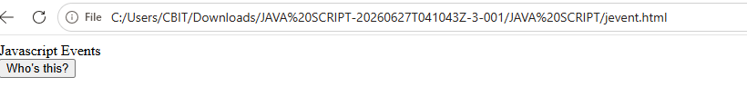
JavaScript Click Event
<html>
<head> Javascript Events </head>
<body>
<script language="Javascript" type="text/Javascript">
<!--
function clickevent()
{
document.write(“CBIT");
}
//-->
</script>
<form>
<input type="button" onclick="clickevent()" value="Who's this?"/>
</form>
</body>
</html>

Slide 45
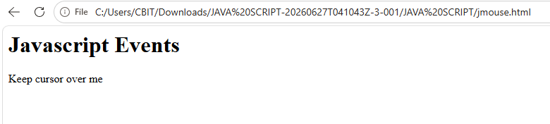
JavaScript Mouse Event
<html>
<head>
<h1> Javascript Events </h1>
</head>
<body>
<script language="Javascript" type="text/Javascript">
<!--
function mouseoverevent()
{
alert(“CBIT");
}
//-->
</script>
<p onmouseover="mouseoverevent()"> Keep cursor over me</p>
</body>
</html>

Slide 46
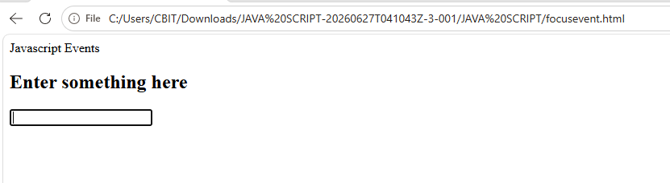
JavaScript Focus Event
<html>
<head> Javascript Events</head>
<body>
<h2> Enter something here</h2>
<input type="text" id="input1" onfocus="focusevent()"/>
<script>
<!--
function focusevent()
{
document.getElementById("input1").style.background=" CBIT";
}
//-->
</script>
</body>
</html>

Slide 47
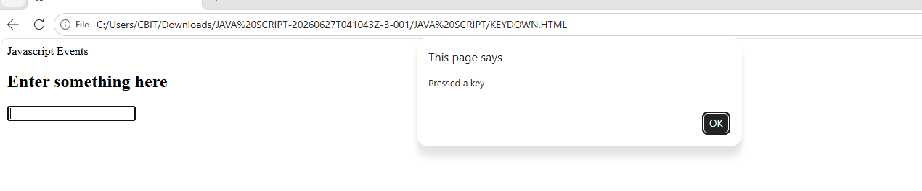
JavaScript Keydown Event
<html>
<head> Javascript Events</head>
<body>
<h2> Enter something here</h2>
<input type="text" id="input1" onkeydown="keydownevent()"/>
<script>
<!--
function keydownevent()
{
document.getElementById("input1");
alert("Pressed a key");
}
//-->
</script>
</body>
</html>

Slide 48
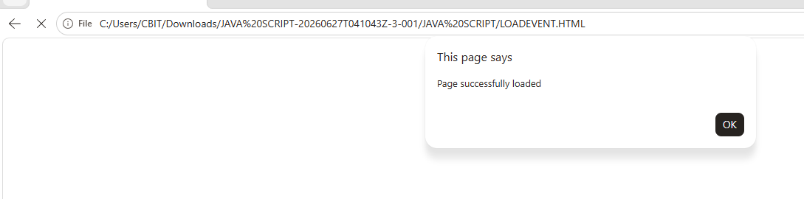
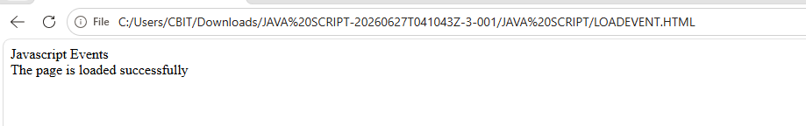
JavaScript Load Event
<html>
<head>Javascript Events</head>
</br>
<body onload="window.alert('Page successfully loaded');">
<script>
<!--
document.write("The page is loaded successfully");
//-->
</script>
</body>
</html>

Slide 49
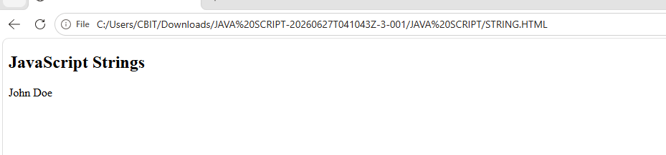
JavaScript Strings
JavaScript strings are for storing and manipulating text.
<!DOCTYPE html>
<html>
<body>
<h2>JavaScript Strings</h2>
<p id="demo"></p>
<script>
let text = "John Doe"; // String written inside quotes
document.getElementById("demo").innerHTML = text;
</script>
</body>
</html>

Slide 50
JavaScript Strings
Method | Description
charAt(index) | returns the character at the specified index
concat() | joins two or more strings
replace() | replaces a string with another string
split() | converts the string to an array of strings
substr(start, length) | returns a part of a string
substring(start,end) | returns a part of a string
slice(start, end) | returns a part of a string
toLowerCase() | returns the passed string in lower case
toUpperCase() | returns the passed string in upper case
trim() | removes whitespace from the strings
includes() | searches for a string and returns a boolean value
search() | searches for a string and returns a position of a match

Slide 51
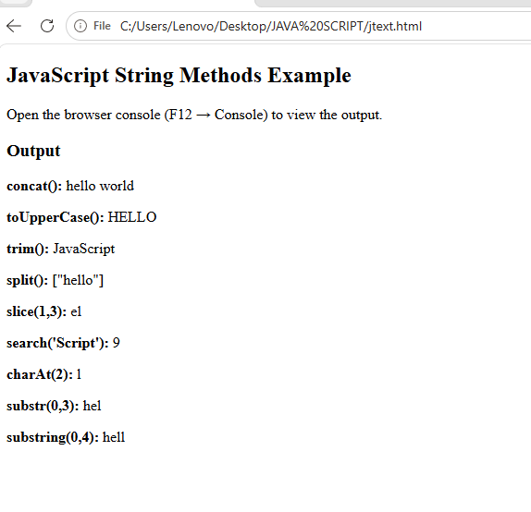
JavaScript Strings
const text1 = 'hello';
const text2 = 'world';
const text3 = ' JavaScript ';
console.log(text1.concat(' ', text2)); // "hello world"
console.log(text1.toUpperCase()); // HELLO
console.log(text3.trim()); // JavaScript
console.log(text1.split()); // ["hello"]
console.log(text1.slice(1, 3)); // "el"
console.log(text3.search("Script")); //9
console.log(text1.charAt("2")); //l
console.log(text1.substr(0,3)); //hel
console.log(text1.substring(0,4)); //hell

Slide 52
JS Date and Time
In JavaScript, date and time are represented by the Date object.
The Date object provides the date and time information and also provides various methods.
Creating Date Objects
new Date()
new Date(milliseconds)
new Date(Date string)
new Date(year, month, day, hours, minutes, seconds, milliseconds)

Slide 53
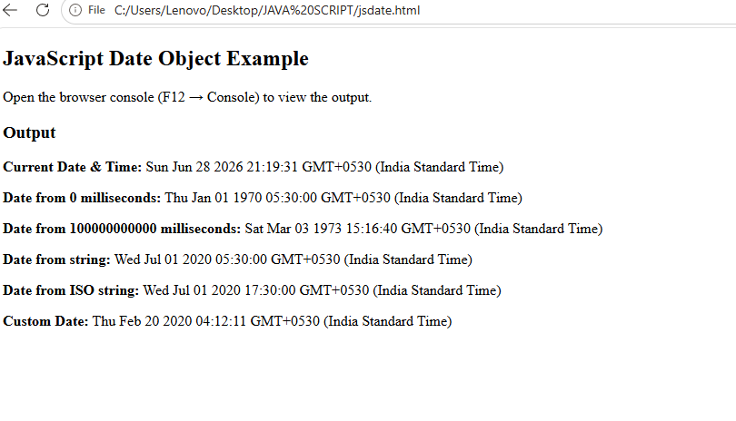
JS Date and Time
const timeNow = new Date();
console.log(timeNow); // shows current date and time
const time1 = new Date(0);
console.log(time1); // Thu Jan 01 1970 05:30:00
const time2 = new Date(100000000000)
console.log(time2); // Sat Mar 03 1973 15:16:40
const date1 = new Date("2020-07-01");
console.log(date1); // Wed Jul 01 2020 05:45:00 GMT+0545
const date2 = new Date("2020-07-01T12:00:00Z");
console.log(date2); // Wed Jul 01 2020 17:45:00 GMT+0545
const time3 = new Date(2020, 1, 20, 4, 12, 11, 0);
console.log(time3); // Thu Feb 20 2020 04:12:11

Slide 54
Object Oriented Programming (OOP) in JS
As JavaScript is widely used in Web Development and some of the Object Oriented mechanisms supported by JavaScript.
There are certain features or mechanisms which makes a Language Object-Oriented like:
Object
Classes
Encapsulation
Inheritance

Slide 55
Object Oriented Programming (OOP) in JS
Object
By using arrays we can store a group of individual objects and it is not possible to store key-value pairs.
If we want to represent a group of key-value pairs then we should go for Objects.
Array: A group of individual objects
Object: A group of key-value pairs
JavaScript objects store information in the form of key-value pairs.
An Object is an instance of a class.

Slide 56
Object Oriented Programming (OOP) in JS
To create empty object:
var nums={}
OR
var nums=new Object()
1st Way: 2nd Way:
nums["fno"]=100 nums.fno=100
nums["sno"]=200 nums.sno=200
var variableName={ key1:value1,key2:value2,...};
var college={ name:‘CBIT', year: 1979, Dept:‘IT' };

Slide 57
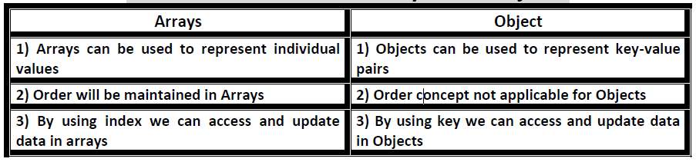
Object Oriented Programming (OOP) in JS
var College=[“CBIT",“MGIT",“VCE",“VNRVJIET"]; var college={ name:‘CBIT', year: 1979, Dept:‘IT' };

Slide 58
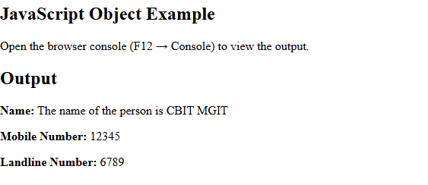
Object Oriented Programming (OOP) in JS
//Defining object
let person =
{
first_name:'CBIT',
last_name: 'MGIT',
//method
getFunction ()
{
return (`The name of the person is${person.first_name} ${person.last_name}`)
},
//object within object
phone_number :
{
mobile:'12345',
landline:'6789'
}
}
console.log(person.getFunction());
console.log(person.phone_number.landline);

Slide 59
Object Oriented Programming (OOP) in JS
Classes–:
Classes are blueprint of an Object.
JavaScript classes, introduced in ECMAScript 2015
JavaScript Class Syntax
Use the keyword class to create a class.
Always add a method named constructor():
class ClassName
{
constructor() { ... }
}

Slide 60
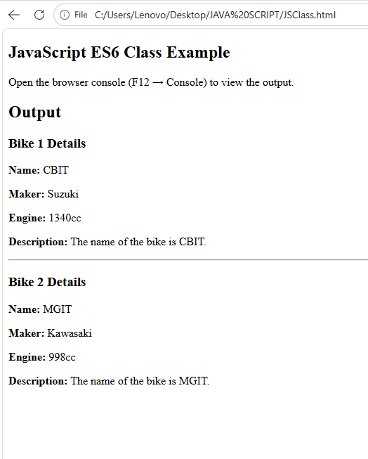
Object Oriented Programming (OOP) in JS
// Defining class using es6
class Vehicle
{
constructor(name, maker, engine)
{
this.name = name;
this.maker = maker;
this.engine = engine;
}
getDetails()
{
return (`The name of the bike is ${this.name}.`)
}
}
// Making object with the help of the constructor
let bike1 = new Vehicle('CBIT', 'Suzuki', '1340cc');
let bike2 = new Vehicle('MGIT', 'Kawasaki', '998cc');
console.log(bike1.name);
console.log(bike2.maker);
console.log(bike1.getDetails());

Slide 61
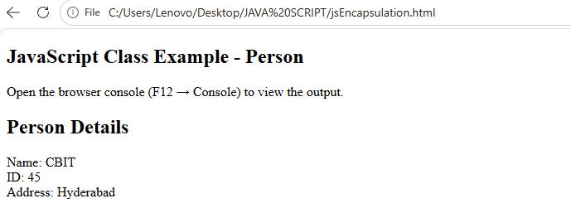
Object Oriented Programming (OOP) in JS
Encapsulation:The process of wrapping properties and functions within a single unit is known as encapsulation.
class person
{
constructor(name,id)
{
this.name = name;
this.id = id;
}
add_Address(add)
{
this.add = add;
}
getDetails()
{
console.log(`Name is ${this.name},Address is: ${this.add}`);
}
}
let person1 = new person('CBIT',45);
person1.add_Address('Hyderabad');
person1.getDetails();

Slide 62
Object Oriented Programming (OOP) in JS
Inheritance – It is a concept in which some properties and methods of an Object are being used by another Object.
Unlike most of the OOP languages where classes inherit classes, JavaScript Objects inherit Objects i.e. certain features (property and methods) of one object can be reused by other Objects.

Slide 63
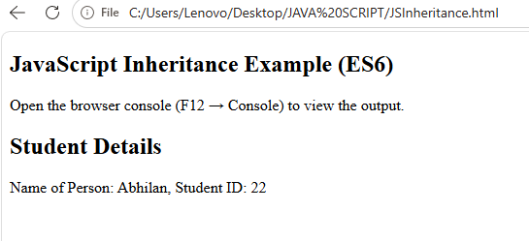
Object Oriented Programming (OOP) in JS
//Inheritance example
class person
{
constructor(name)
{
this.name = name;
}
//method to return the string
toString(){ return (`Name of person: ${this.name}`); }
}
class student extends person
{
constructor(name,id)
{
//super keyword for calling the above class constructor
super(name);
this.id = id;
}
toString()
{
return (`${super.toString()},Student ID: ${this.id}`);
}
}
let student1 = new student('Abhilan',22);
console.log(student1.toString());

Slide 64
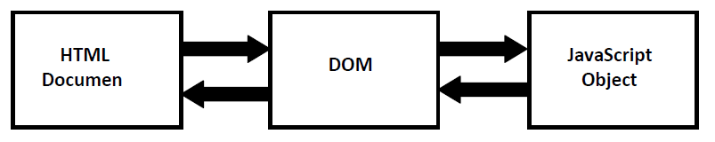
Document Object Model (DOM)
DOM acts as interface between JavaScript and HTML, CSS.
Browser will construct DOM.
All HTML tags will be stored as JavaScript objects.
t

Slide 65
Document Object Model (DOM)
To display Document to the console:
Just type on JavaScript console: document
Then we will get total HTML Page/Document.
To Display DOM Objects on the Console:
console.dir(document)
Observe that Root element of DOM is document.
DOM Attributes:
1) document.URL :This is original URL of the website.
2) document.body :It returns everything inside body.
3) document.head :It returns head of the page.
4) document.links :It returns list of all links of the page.

Slide 66
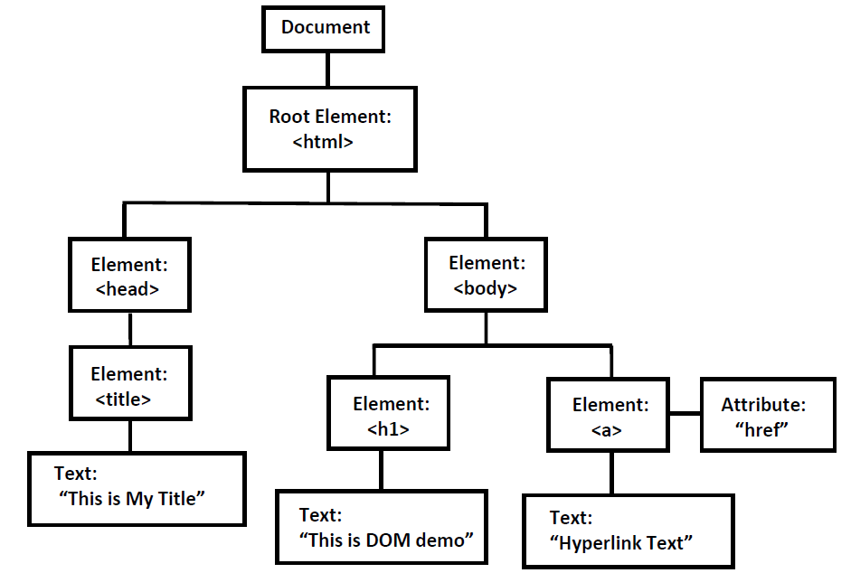
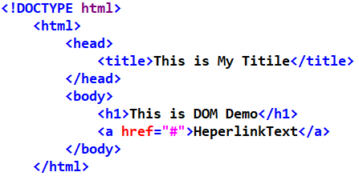
Document Object Model (DOM)
https://software.hixie.ch/utilities/js/live-dom-viewer/

Slide 67
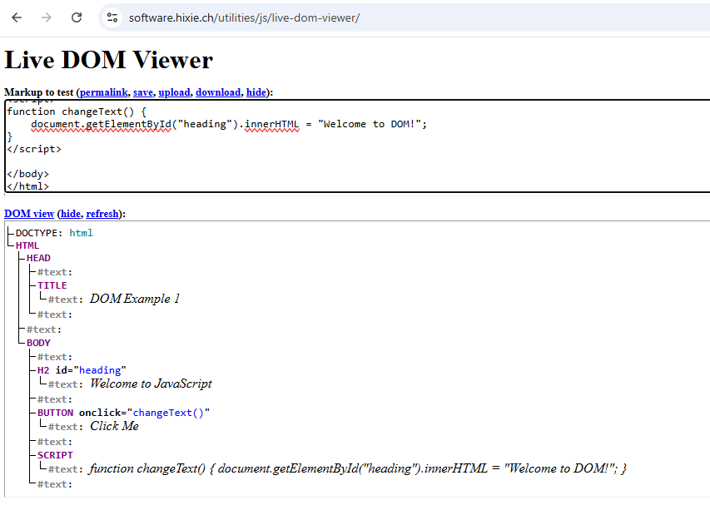
Document Object Model (DOM)
How to grab HTML Elements from the DOM?
1) document.getElementById()
Returns element with the specified id.
2) document.getElementsByClassName()
Returns list of all elements belongs to the specified class.
3) document.getElementsByTagName()
Returns list of all elements with the specified tag.
4) document.querySelector()
Returns the first object matching CSS style selector.
5) document.querySelectorAll()
Returns all objects Matches the CSS Style Selector.

Slide 68
JavaScript Regular Expressions
In JavaScript, a Regular Expression (RegEx) is an object that describes a sequence of characters used for defining a search pattern.
/^a...s$/
The pattern is: any five letter string starting with a and ending with s.
Create a RegEx
Using a regular expression literal:
cost regularExp = /abc/;
Using the RegExp() constructor function:
const reguarExp = new RegExp('abc');
https://regex101.com/

Slide 69
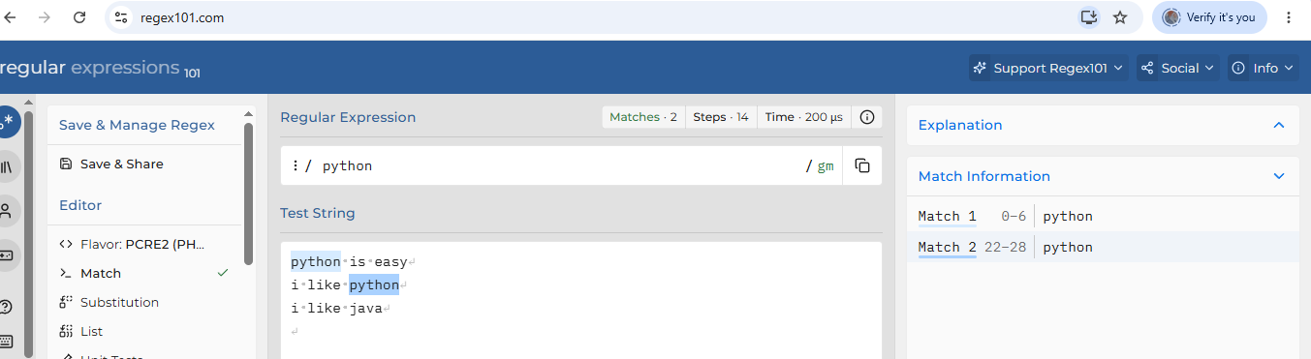
JavaScript Regular Expressions
Using String Methods
In JavaScript, regular expressions are often used with the two string methods: search() and replace().
The search() method uses an expression to search for a match, and returns the position of the match.
The search method returns the position in the String object at which the pattern matched.
If there is no match, search returns –1.
The position of the first character in the string is 0.
The replace() method returns a modified string where the pattern is replaced.

Slide 70
JavaScript Regular Expressions
var str = "Rabbits are furry";
var position = str.search(/bits/g);
if (position >= 0)
document.write("'bits' appears in position", position,"<br />");
else
document.write("'bits' does not appear in str <br />");
output:
'bits' appears in position 3

Slide 71
JavaScript Regular Expressions
<!DOCTYPE html>
<html>
<body>
<h2>JavaScript String Methods</h2>
<p>Replace "Microsoft" with “Google" in the paragraph below:</p>
<button onclick="myFunction()">Try it</button>
<p id="demo">Please visit Microsoft!</p>
<script>
function myFunction()
{
let text = document.getElementById("demo").innerHTML;
document.getElementById("demo").innerHTML = text.replace("Microsoft",“Google");
}
</script>
</body>
</html>

Slide 72
JavaScript Regular Expressions
Method | Description
exec() | Executes a search for a match in a string and returns an array of information. It returns null on a mismatch.
test() | Tests for a match in a string and returns true or false.
match() | Returns an array containing all the matches. It returns null on a mismatch.
matchAll() | Returns an iterator containing all of the matches.
search() | Tests for a match in a string and returns the index of the match. It returns -1 if the search fails.
replace() | Searches for a match in a string and replaces the matched substring with a replacement substring.
split() | Break a string into an array of substrings.

Slide 73
JavaScript Regular Expressions
const string = 'Find me';
const pattern = /me/;
// search if the pattern is in string variable
const result1 = string.search(pattern);
console.log(result1); // 5
// replace the character with another character
const string1 = 'Find me';
string1.replace(pattern, 'found you'); // Find found you
// splitting strings into array elements
const regex1 = /[\s,]+/;
const result2 = 'Hello world! '.split(regex1);
console.log(result2); // ['Hello', 'world!', '']
// searching the phone number pattern
const regex2 = /(\d{3})\D(\d{3})-(\d{4})/g;
const result3 = regex2.exec('My phone number is: 555 123-4567.');
console.log(result3); // ["555 123-4567", "555", "123", "4567"]

Slide 74
JavaScript Regular Expressions
MetaCharacters are characters that are interpreted in a special way by a RegEx engine.
[] - Square brackets -Square brackets specify a set of characters you wish to match.
. - Period-A period matches any single character (except newline '\n').
^ - Caret-The caret symbol ^ is used to check if a string starts with a certain character.
$ - Dollar-The dollar symbol $ is used to check if a string ends with a certain character.
* - Star-The star symbol * matches zero or more occurrences of the pattern left to it.
+ - Plus-The plus symbol + matches one or more occurrences of the pattern left to it.
? - Question Mark -The question mark symbol ? matches zero or one occurrence.
| - Alternation- Vertical bar | is used for alternation (or operator).

Slide 75
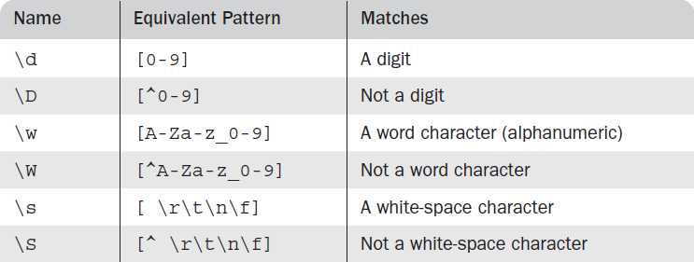
JavaScript Regular Expressions
/\d\.\d\d/ // Matches a digit, followed by a period, // followed by two digits.
/\D\d\D/ // Matches a single digit.
/\w\w\w/ // Matches three adjacent word characters

